Slide 1
Website Design
www.foodgawker.com
Prepared by: Martin Genesis E. Gamban

Slide 2
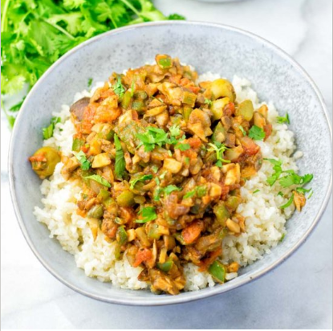
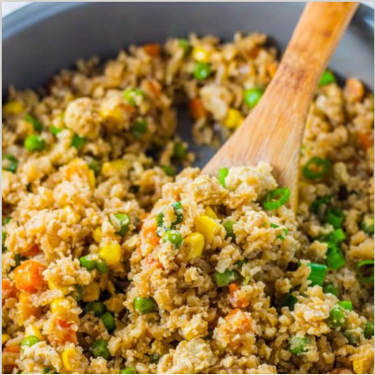
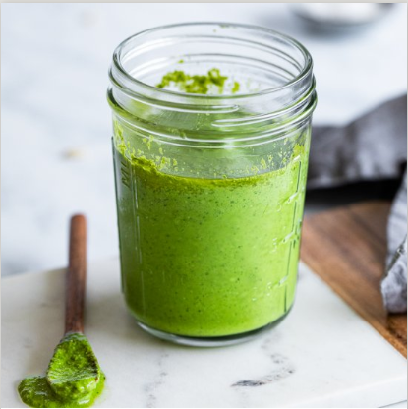

foodgawker
page 1
latest
all time
search
categories
favorites
#830827 contentednesscoolking
This Cuban Picadillo is super easy to make and is packed with flavor! Hearty, filling and a must make for everyone!
#830826 savorandsavvy.com
Cauliflower Fried Rice recipe that's a quick and easy vegetarian dinner!
#830825 jernejkitchen
#830824 feelgoodfoodandmore
Spinach Basil Pesto Sauce is such an amazing recipe that you can use for a variety of dishes. Made in just 10 minutes.
Kartoffel-Kohlrabi Gratin mit Tomaten ist eine tolle Abwechslung zum normalen Kartoffelgratin. In German
0
0
0
0
0
0
0
0

